Slide 1

Interim Presentation
Developing a Full-Stack Web Application with OCR Functionalities using the MERN Stack
Clemente Gonzales – N00193107

Slide 2
Project Background
The project will be a web based application
A notes taking application
Application should contain a user-friendly design
Containing OCR functionality
Notes:
Using the MERN Stack, more on this later
A notes taking app similar to that of Notion or Evernote
App should be user friendly in design, and will be discussed on later on
OCR – Optical Character Recognition
Which is when a person can send an image containing text to a program, and retrieve the words and letters and the program can give it back to the user
For example it can be seen in google translate, where it can read and translate the text

Slide 3
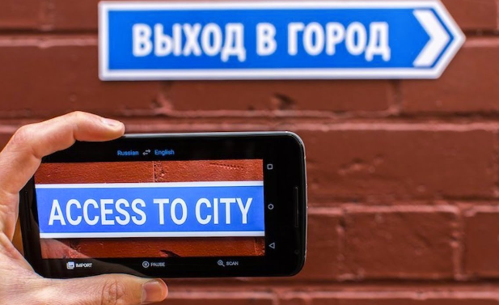
OCR Example

Slide 4
Existing Applications
Notion
Google Keep
Evernote
Text Scanner [OCR]

Slide 5
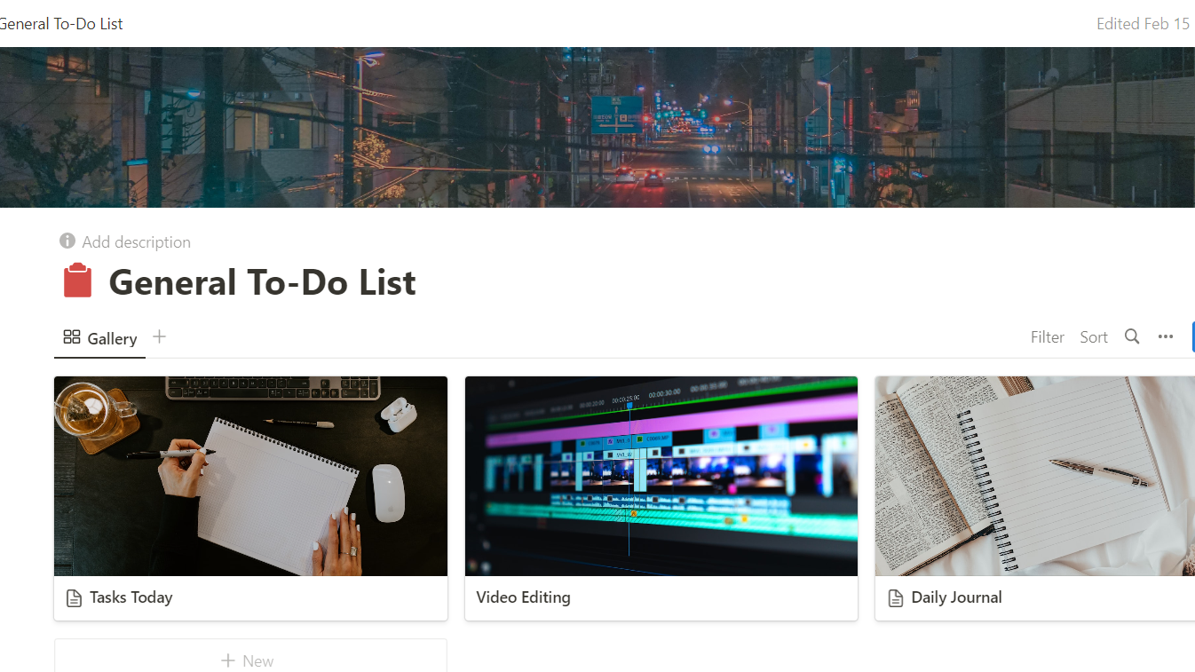
Notion
Notes:
Notion is a notes taking app
Lot of features, such as sort, to-do list and rich text editor that allows users to customize their notes
One downside about notion, is that a lot of users from the interviews thought it contained a slightly confusing UI

Slide 6
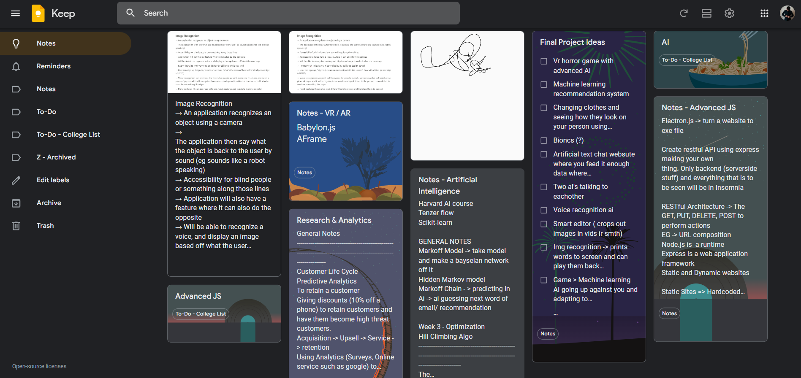
Google Keep
Notes:
Similar to notion where you can take notes
More of a to-do list app, that google has
Not as deep of a notes taking app as notion
One cool thing about google keep is that it actually contains OCR functionalities

Slide 7
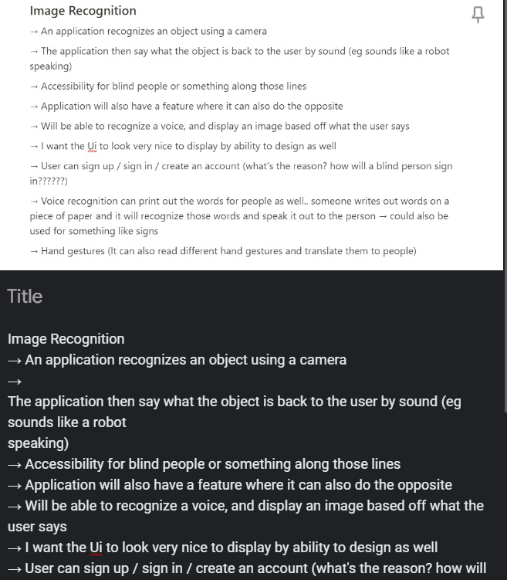
Google Keep ocr example

Slide 8
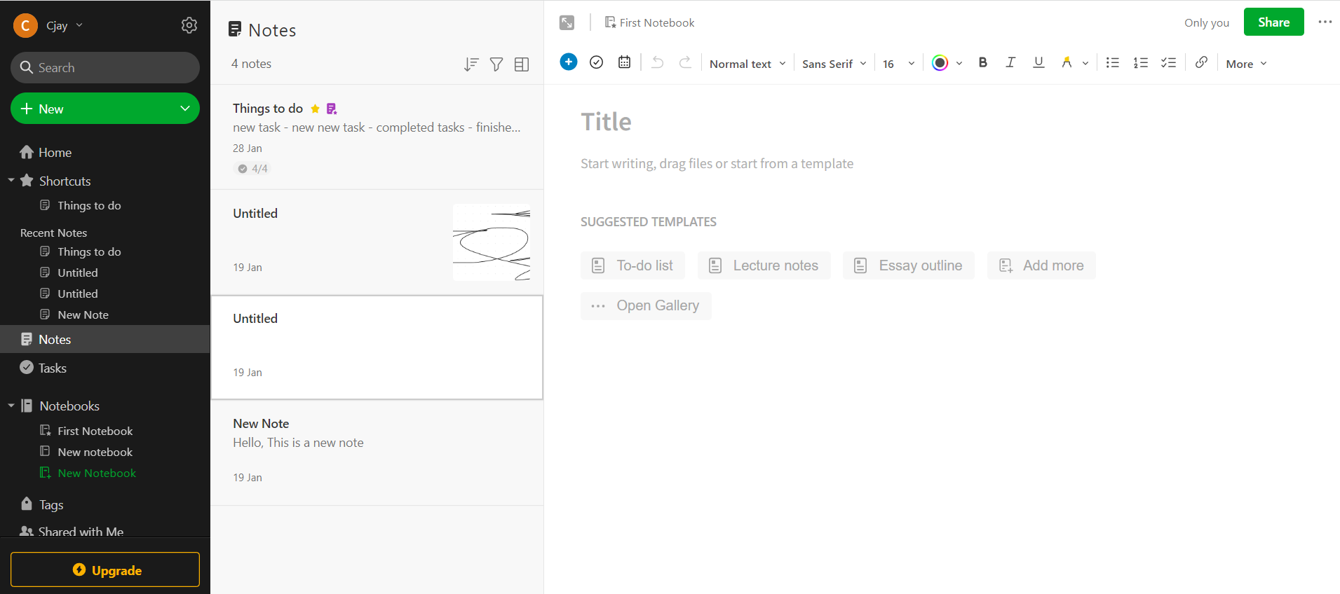
Evernote
Notes:
Similar to Notion
It contains a rich text editor, sorting options, and a draw option
However it is a lot more user-friendly than notion and UI is a lot easier and simpler to use
However the drawback is that some features are locked behind a paywall

Slide 9
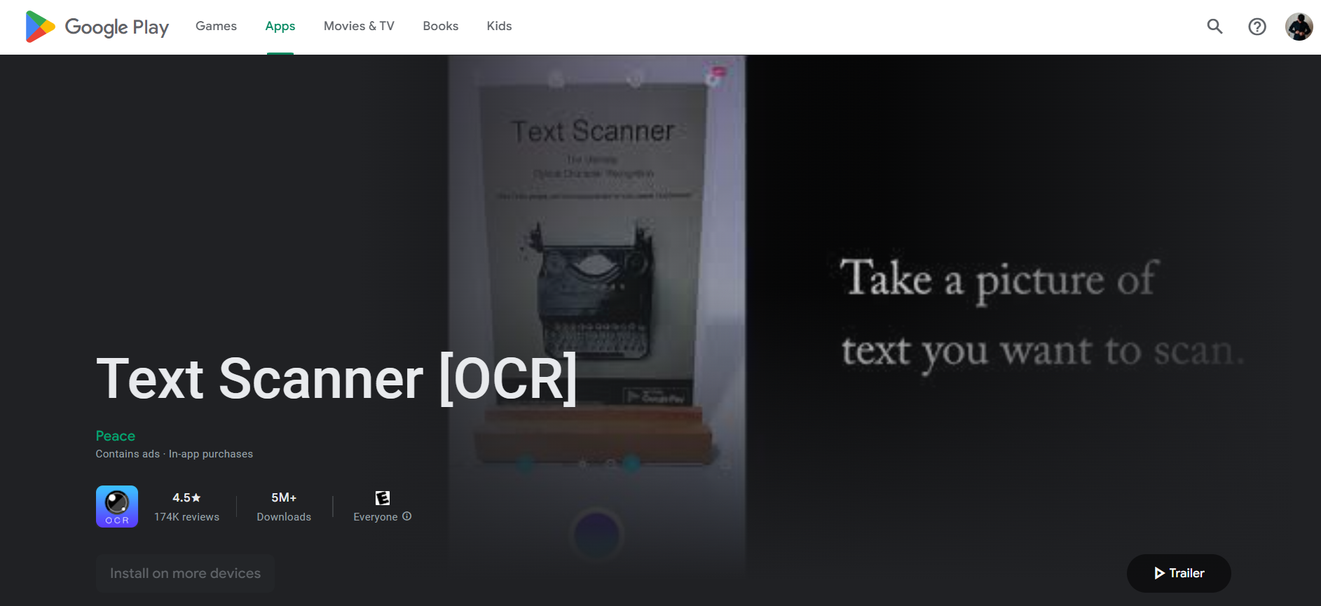
Text scanner [ocr]

Slide 10
Research
Viewing Similar Applications
Interviews
Survey
Notes:
Similar Apps ->
I mainly looked at notion, evernote, and google keep and looked at their functionalities and the benefits they provided and their downsides
I then conducted interviews, asking them about the applications notion and such, and applications that they used too
A few extra features that can potentially be added were brought up during these interviews
One of which is a global search feature, where a user can search a specific phrase for example, and the system will go through all files and bring back the result seen
Another is simply having a bunch of sort options
These features could potentially be added towards the end of development to polish the application
Finally surveys were conducted to gather mass data on opinions on various things

Slide 11
Technologies
React.js
MERN Stack
Tesseract OCR
Quill.js
Socket io
Figma
Notes:
React.js is the front end that will be used to develop the application
MERN Stack was the full stack
MERN Is for Mongo, Express, React, Node
Tesseract OCR -> Library used for OCR functionalities
Quill.js -> will be used for the notes taking app
Socket io -> Share
Figma -> Figma was used to design the application

Slide 12
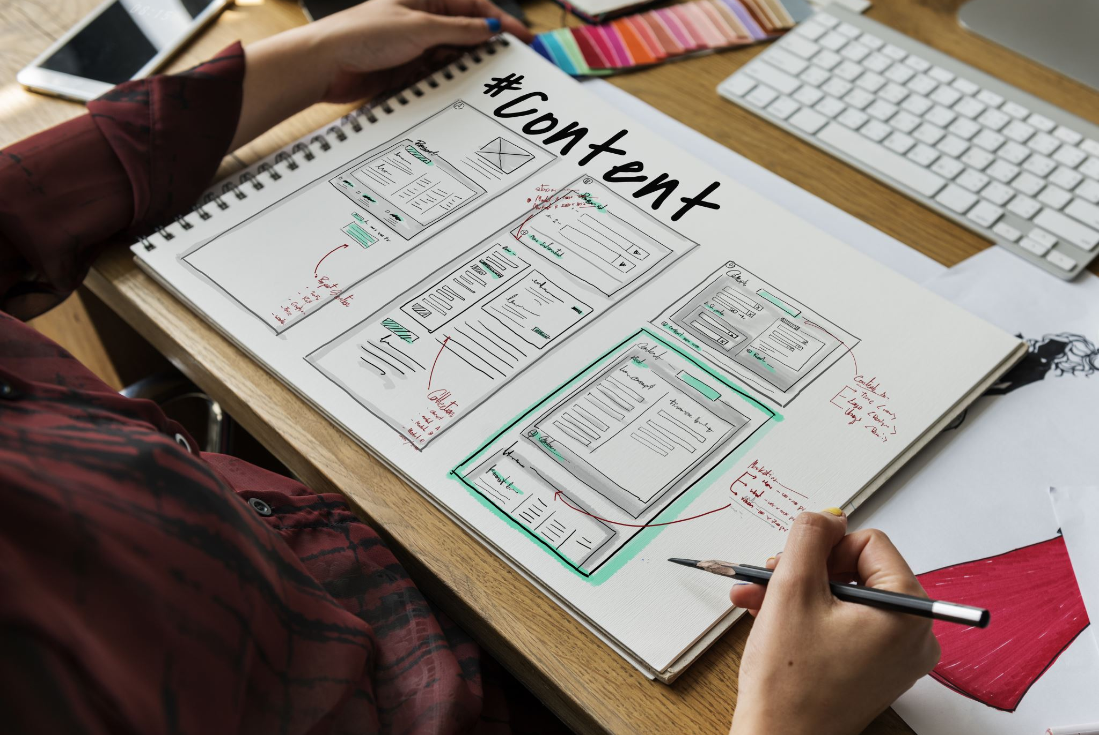
Implementation Plan

Slide 13
Sprints
Sprint 1 – Research and Prototype OCR Functionality
Sprint 2 – Design the User Interface and Backend of Application
Sprint 3 – Prototype Development of Text Editor and Folder Structure
Sprint 4 – Complete the development of Backend
Sprint 5 – Connect the existing prototypes together to create a skeleton
Sprint 6 – Begin implementing design of application
Sprint 7 – Add React Native to allow for mobile compatibility
Sprint 8 – Implement extra features where possible
Sprint 9 – Implement extra features where possible
Notes:
The implementation of this project uses the SCRUM methodology
Scrum divides the workload of the project into sprints, where a developer can break down the project making it smaller for easier development
Sprint 2 -> Some things may change
Sprint 3 -> Some parts still aren’t complete
Sprint 4 -> Backend may change
Sprint 5 -> Already working on that

Slide 14
Work in progress demonstration

Slide 15

Questions?

Slide 16
Thank you!

